Slide 1
Tartans Texas Hold’em
Team 20 - Presentation
Team:
Yunshan Zhang, Renjie Zhong, Haoxuan Yuan, Junhui Li

Slide 2
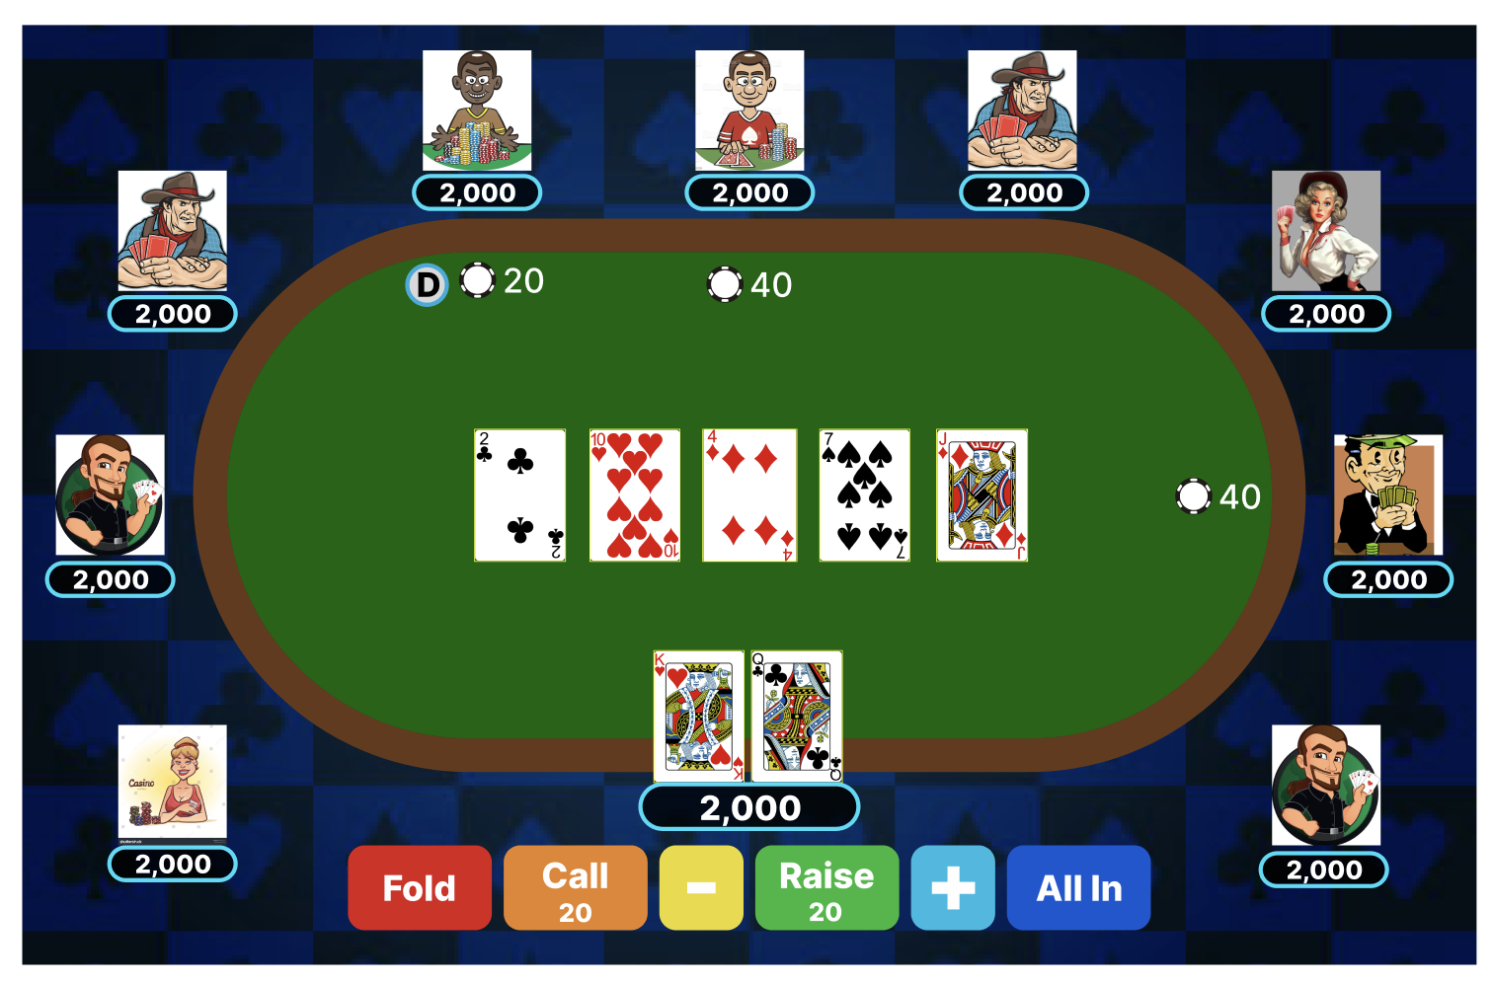
Project Definition
A website for playing Texas Hold’em online with multiple players optionally

Slide 3
Product Backlog
User information logics - Junhui Li
Register
Login
Logout
Access Profile
Room logics - Yunshan Zhang
Enter room
Exit room
Game logics - Haoxuan Yuan / Renjie Zhong
Be prepared
Create a new game
Play game
Global information - Yunshan Zhang
Leaderboard

Slide 4
First Sprint Backlog
User information logics - Junhui Li
Register
Login
Logout
Room logics - Yunshan Zhang
Enter room working HTML
Exit room working HTML
Game logics - Haoxuan Yuan / Renjie Zhong
Be prepared working HTML
Create a new game working HTML
Play game working HTML
Global information - Yunshan Zhang
Leaderboard - Working HTML and Demonstrate database real data

Slide 5
Work Finished
Finish HTML pages designs
Finish initial database model design
Distribute future work based on modules

Slide 6
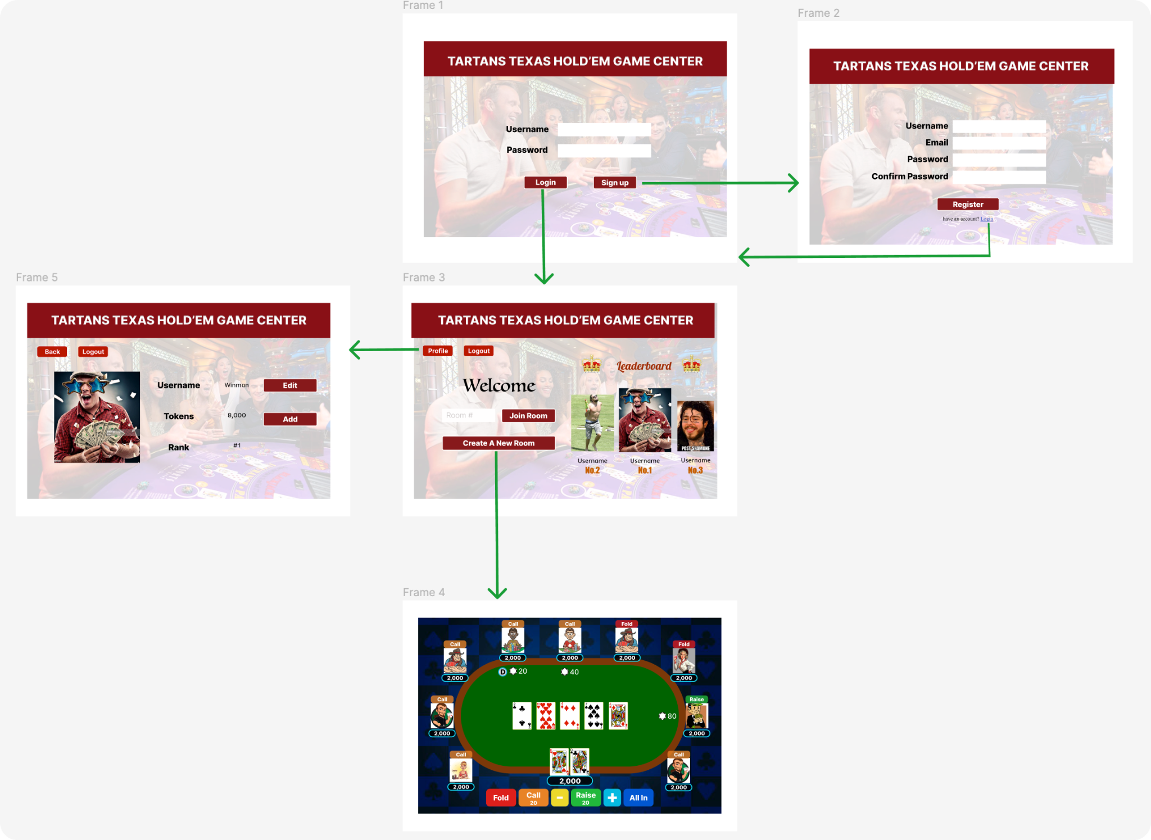
HTML Implementation

Slide 7
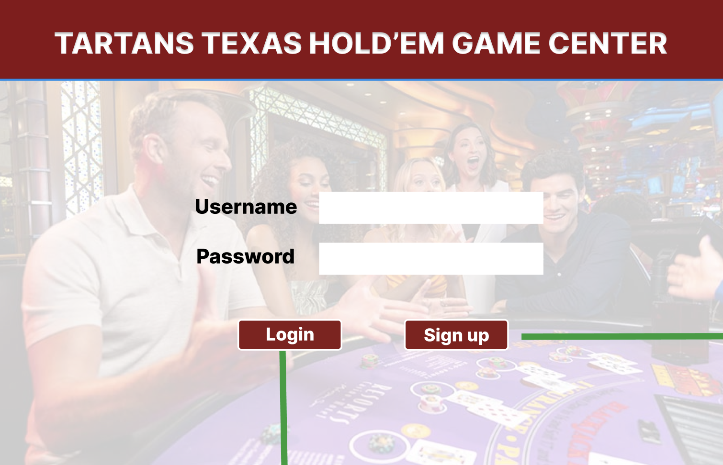
Login Page

Slide 8
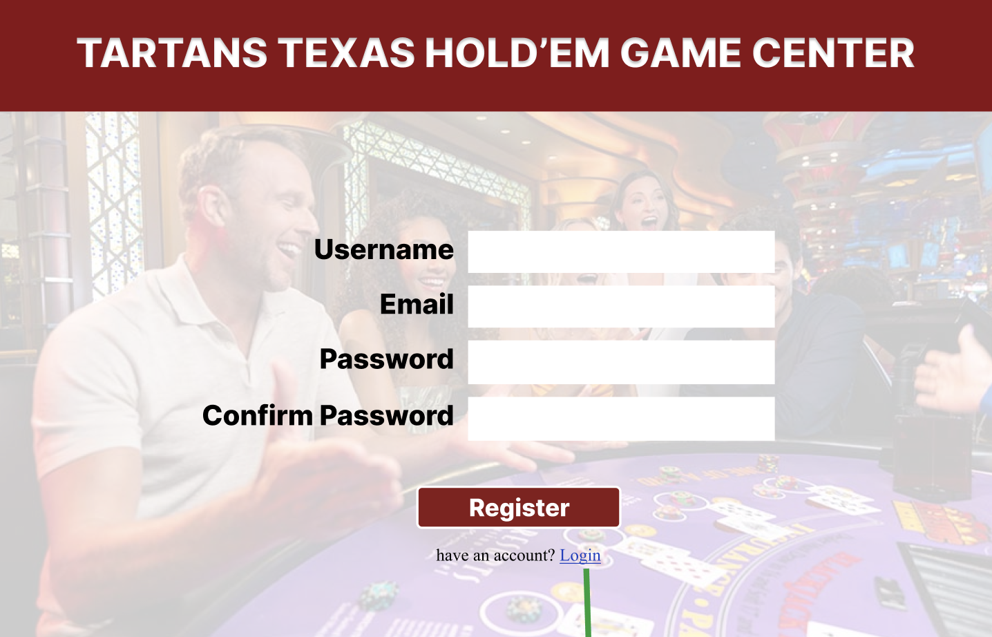
Register Page

Slide 9
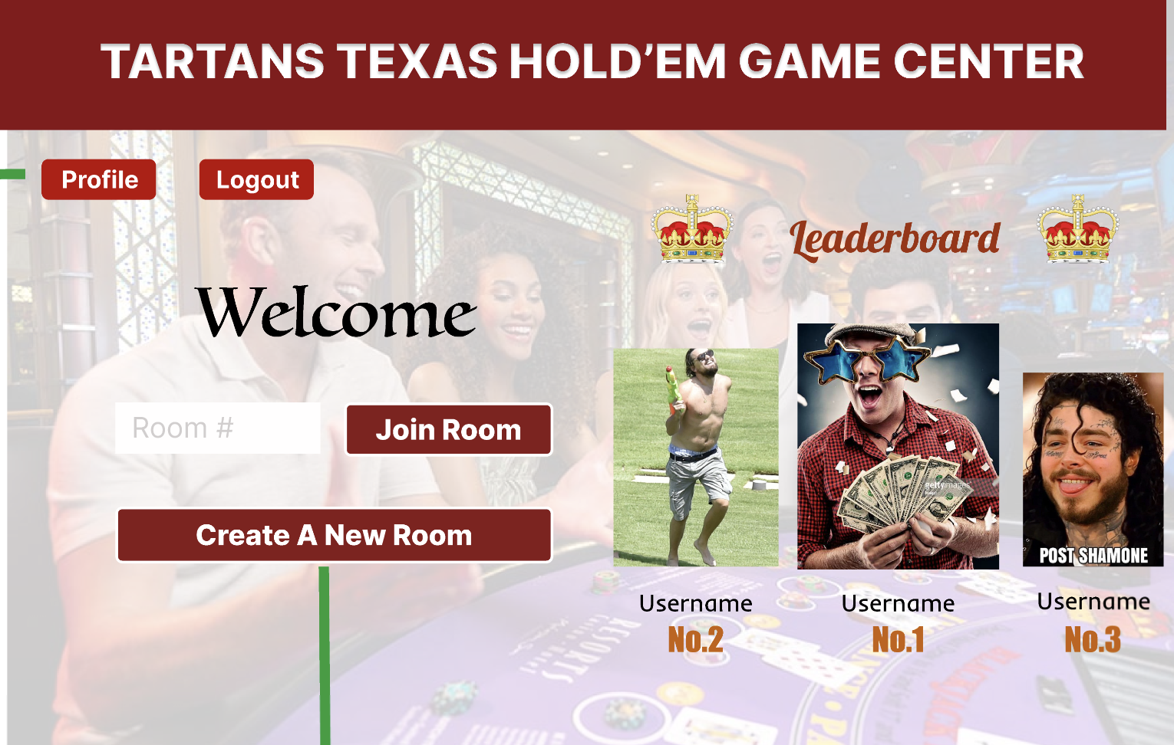
Game Lobby

Slide 10
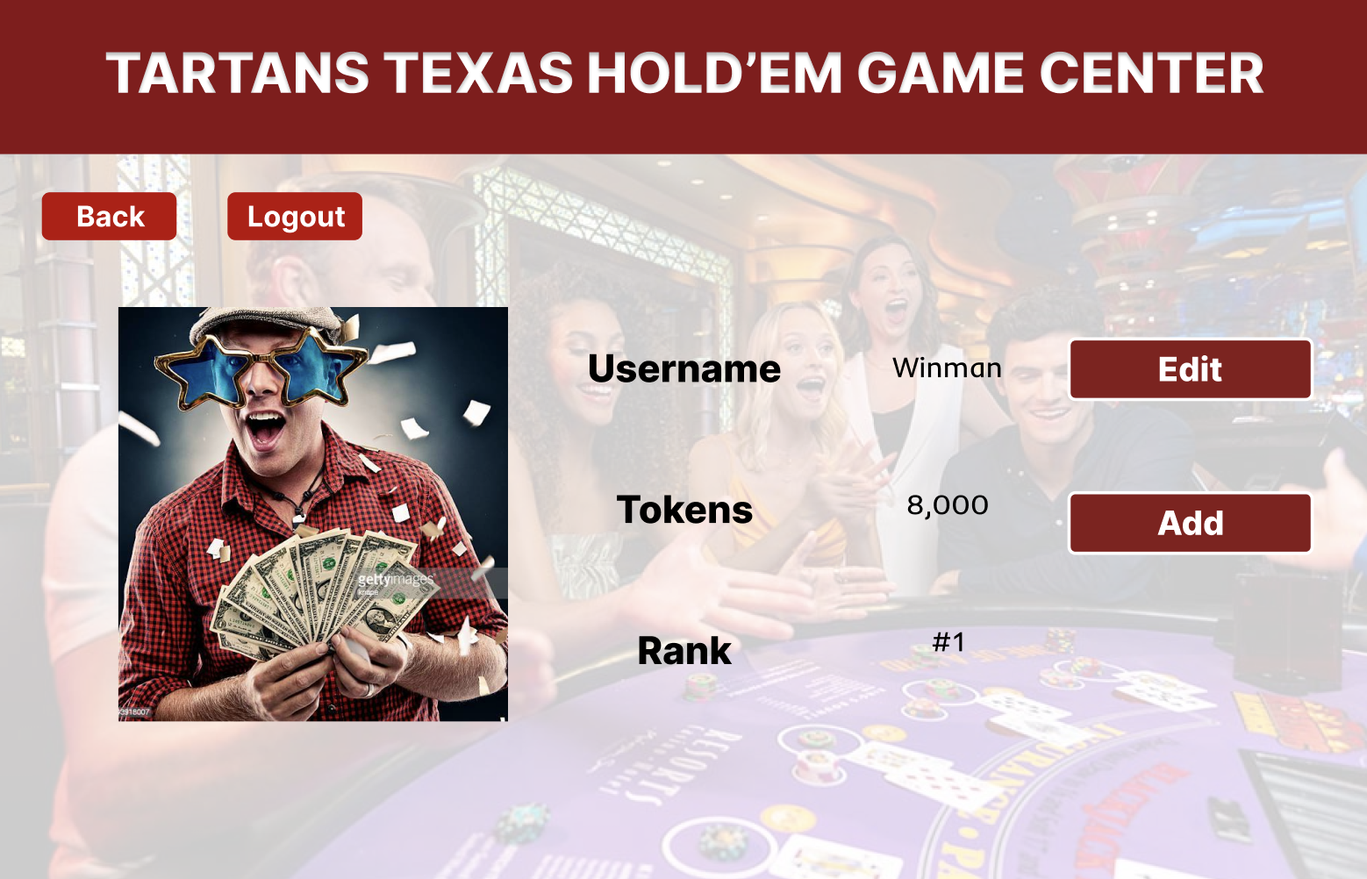
User Profile

Slide 11
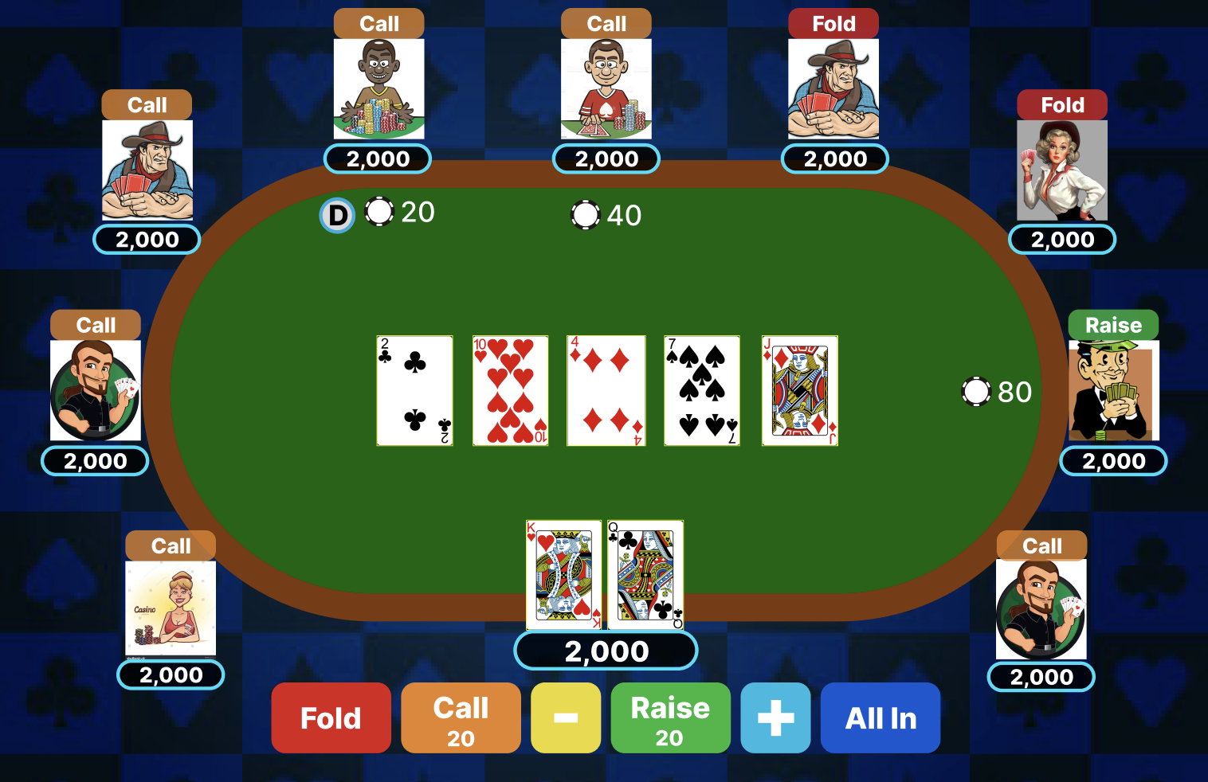
Game Page

Slide 12
Data Model Design
Framework - Django
Profile model:
user - user id for the profile
picture - uploaded by user
rank - ranking in the leaderboard
tokens - addable gambling chips

Slide 13
Thank you for watching

